Slide 1
How to install App from Google Play

Slide 2
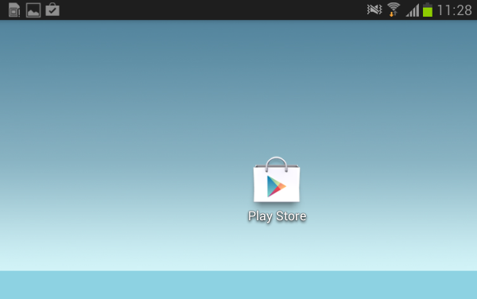
1- Click on Google Play store icon.

Slide 3
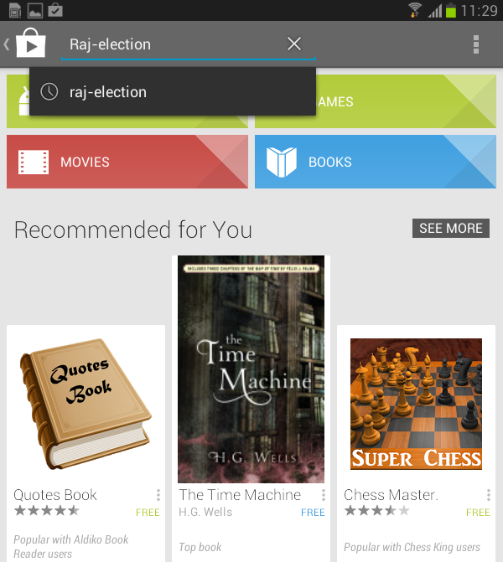
2- Type Raj-Election in serach bar of google play store and click on serach button.

Slide 4
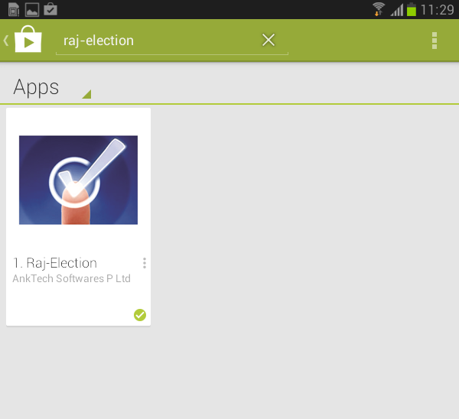
3- You will find the Raj-Election Application. Please click on the App link to go to detail page.

Slide 5
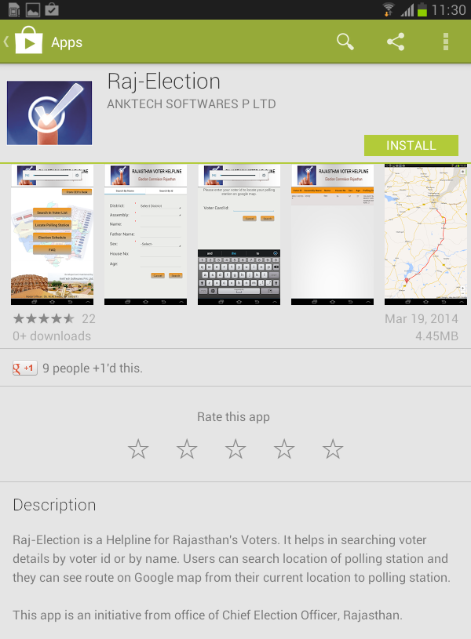
4- After step 3 you will get whole application page and all description about app. Please click on install button to install this app on your mobile phone.

Slide 6
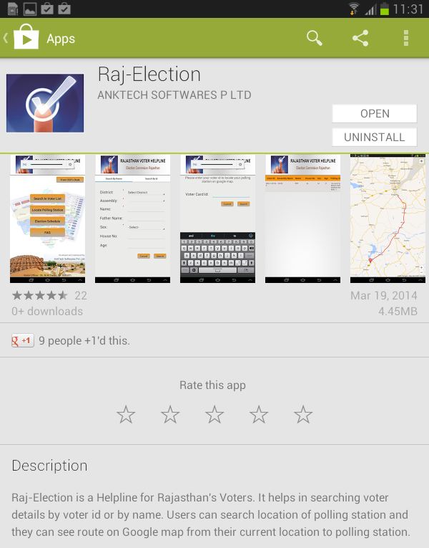
5- After step 4, to open this application please click on open button, Then you will come on application and you can use it.

Slide 7
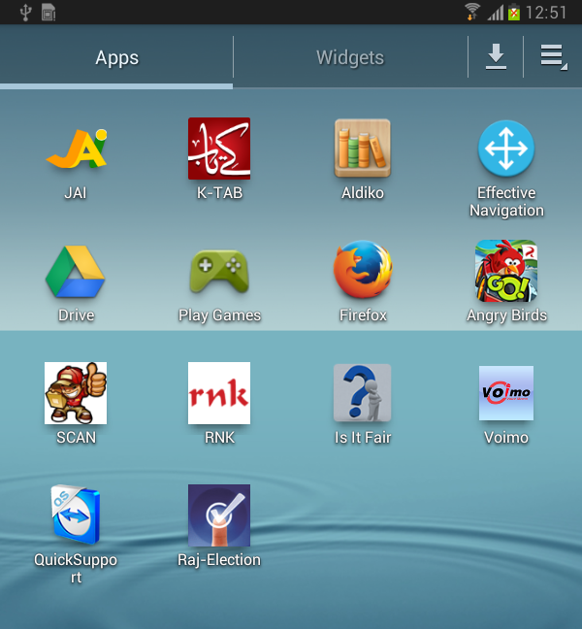
6 - When app is downloaded it will create an app icon on Apps screen/ Home screen. Click on this app icon to use app next time.

