Slide 1
ERONet
March 10, 2017

Slide 2
Background
States & UT have ER
Online Forms for forms 6, 6A, 7, 8, 8A are available for users from nvsp.in
Forms can also be submitted online from APP
These forms are currently pushed to state for processing
For the forms submitted online processing is to be undertaken online on ERONet
Offline forms will be scanned and digitized and processed similarly
The ER is to be maintained centrally
Making handling transpositions easy
Avoid Errors and Multiple entry

Slide 3
Common Deficiencies in ERs Maintenance
Notice/Intimation is not given while deleting the electors entries from the ERs either through form-7 or Suo-Moto on Shifting/Absent electors cases.
Delay in prompt disposal of claims and no information to the applicant on the status processing of his application.
Quality of BLO field verification is neither uniform nor monitored by supervisory officers on a continuous basis.
Part –IV is often not filled in majority of the applications leading to multiple entries and multiple EPICs.
Part III information is not often filled in causing wrong section formations
Declaration from over 25 years’ first time applicants is not insisted.
Systematic Deletion of entries on Part-IV on shifting in Form-6 from the earlier Rolls based is missing

Slide 4
Common Deficiencies in ERs Maintenance
Disposal of Death cases- both Registered as well as unregistered is not systematic.
The potential of about one Lakh field Supervisors is not realised.
There is general delay in issuing EPIC cards, quality, look of the EPIC varies from state to state.
Disposal of objections and process of hearing not standardized.
Record keeping is not standardised,
Not possible to monitor the quality of regular disposal.
Protocol for issuing duplicate EPIC/ updated EPIC is not being uniformly followed.
The Poor quality of Photographs,
Logical Errors in the entries,
Incorrect details in the Entries particularly address and translation in the second/third language.

Slide 5
Common Deficiencies in ERs Maintenance
There is no continuous and sustained monitoring of the health indicators of the ERs viz. EP ratio, Gender Ratio and Age- Cohort comparison with projected Census population.
The BLO registers are not maintained properly
ER records maintenance is not satisfactory in many states.
Splitting of family members across Rolls while creating Sections,
Improper or no clear demarcation of Section boundaries,
Lack of scientific rationalization of boundaries and locations of the Polling Stations

Slide 6
ERO_Net
ERO-Net brings in seamless processing of forms, easy handling of the databases, regular and simpler way of monitoring the ERs activities and maintaining the ERs health.
The system has three major components,
ERO-Net links all EROs of Nation.
UNPER Unified National Photo Electoral Rolls
NVSP Citizen Electoral services.
The overall scope of ERO-Net is to develop a web based system for Electoral officials.

Slide 7
The ERO-NET - functionalities of ER
Processing of electoral forms
Maintain electoral rolls
Polling Stations Management System
Communication between EROs across ACs and States
Simultaneous addition and deletion process in migration, shifting
Methodical deletion of Dead Voters
Anytime real time observance of ER Health parameters like Age Cohort, PER, male-female ratio
Connected with single source of online forms acceptance (through NVSP), it provides real time monitoring of progress of the form processing (Status of the forms submitted )

Slide 8
The ERO-NET – functionalities- forms’ Handling
New forms submitted would first be checked for
Correctness of data entry
If the applicant is already registered, the details there of, helping EROs to take correct decisions
Quality of photographs and documents.
Checklist based BLO verification will bring in objectivity, transparency and accountability in the process.

Slide 9
The ERO-NET – Records of Deletion
In case of deletion, proper records of deletion, notices are generated, issued and notice served details captured.
Easy to use Dashboard for DEOs, CEOs, ECI officials and EROs themselves for single window view
Management of BLOs, Supervisors
Its multilingual, can be used in Regional Languages
Since Mobile apps are properly attached with the system, DEOs, EROs and AEROs can view status and progress details from anywhere and control/ manage delay/defficiencies in the process by direct call to the concerned official like BLO, Supervisor

Slide 10
The ERO-NET - Alerts
SMS/ Mobile App./ email alerts in the system, indicates to BLO, AERO, ERO, DEO etc about arrival or completion of the activities on their part, reducing pendency
SMS (email) to other EROs for suitable actions based on Part IV info in forms 6
SMS SMS/ Mobile App./ email alerts to citizens about the
Status of processing of their forms
scheduled hearing.
Outcome : Rejection with Reason, approval etc.
EPIC No. and Card printing status

Slide 11
The ERO-NET – Electoral Services
Web Portal (NVSP),
Mobile App (Android, iOS, Windows),
SMS gateway,
E-mail.
Notices generation to be delivered by BLO/ post

Slide 12
The ERO-NET – Citizen services
Name search, part & Serial No.
Online Submit form 6, 6A, 7, 8, & 8A with supporting documents.
Tracking the status of filled application including auto alerts.
Details of Polling Station (PS),
Details of Assured Minimum Facilities (AMF)
How to reach your PS using GPS, Google Earth, Google Maps and Key Map.
Know your Electoral Officers- BLO, Supervisors, Election Officer/ Nayab Tahsildar, AERO/ ERO, DEO & CEO.
Step by step guide on enrolment & FAQs, Information on legal provisions relating to enrolment.
Voluntarily furnishing information to ensure health of ER such as contact details, linking family members, un enrolled family members’ details, members going to become eligible for voter ID card (attains age of 18 years) in next summary revision, details of shifting/ absent/ dead of any elector etc.

Slide 13
Training and Feedback from States/UTs
772 officials from all 36 States/UTs were trained from Oct 2016 till Dec 2016
Documentation prepared
ERO Handbook
ERO manuals for ERO, AERO, Supervisor, BLO, Scanning& QR
Training material in PPT form,
9 minutes Audio Visual Film
Various Pamphlets and Fliers
Feedback received from 27 states-
WB, Assam, AP & Telangana, Kerala, Gujrat, Karnataka, Odisha, MP, Punjab, UK, TN, Delhi, Maharashtra, Bihar, Rajasthan, Goa, Jharkhand, Chattisgarh, Meghalaya, Tripura, Manipur, DNH, Lakshadweep, A&N, D&D, Chandigarh, J& K

Slide 14
Major Feedback pointers
Multilingual..... Done
Inclusion of Form 001 .... Done
Minimum number of Alerts ..... Done
Clean Dashboard.....done
Part and Section Assignment.....Done
New Format of Forms..... Done
BLO check List update....Done
Autofill of fields if EPIC given.... Done

Slide 15
Preparation for Launch and Schedule
Full fledged Demo of COMPLETE System to be arranged on 9th, 10th and 11th March 2017
DECs/DG to see demo and take VC with All CEOs on 9th March
On 9th Select CEOs may be invited for Demo
Commission to view Demo on 10th March 2017 and advice, if any
C-DAC to migrate ERO Net from Development to Production Platform ( 11th April to 20th April 2017)

Slide 16
Preparation for Launch and Schedule
One day training to CEO, SLA, Master Trainers, DEOs, EROs by DIR IT and DIR KP with Zonal Secretaries in all States -from 15th March till 10th April 2017.
DECs/ DG may join the training as per convenience.
Commission may like to chair training in some States.
Launch on suitable date between 11th to 30th April 2017 in one or two phases - 5 poll gone states and poor connectivity states/UTs in second phase.

Slide 17
State Level ERONET Trainings
State Level ERONET Trainings
S.No. | Date | State name | No. Of Participants
1 | 3-Sep-16 | Training to Master trainers of States | 36
2 | 10-Sep-16 | Training to Master trainers of States | 50
3 | 17-Sep-16 | Training to Master trainers of States | 83
4 | 10-Nov-16 | Chandigarh and Haryana | 40
5 | 28-Nov-16 | Madhya Pradesh | 100
6 | 30-Nov-16 | Kerala | 40
7 | 6-Dec-16 | Goa | 5
8 | 7-Dec-16 | Chandigarh and Haryana | 50
9 | 8-Dec-16 | Goa | 15
10 | 12-Dec-16 | Lakshdweep | 5
11 | 13-Dec-16 | Goa | 25
12 | 14-Dec-16 | Goa | 30
13 | 19-Dec-16 | Delhi | 40
14 | 20-Dec-16 | Delhi | 40
15 | 21-Dec-16 | Jharkhand | 100
16 | 22-Dec-16 | Jharkhand | 110
17 | 9-Feb-17 | Arunachal Pradesh | 2
 |  | Total | 771

Slide 18
Training Feedback
AERO remarks in the drop down menu of the ERO form panel should be customized as per state requirements.
For MP, form entry has to be Hindi to English instead of English to Hindi.
View dashboard should have provision to export to excel file that can be printed for reporting in file.
Request received from other ERO for deletion of an applicant’s name as per Part 4 entry is not visible currently in the ERO Net software.
If remarks of the BLO/AERO do not match on the decision taken for Rejection/Acceptance by the ERO, the system should display a warning message to the ERO.
DSE should be listed with photograph.

Slide 19
After submission of application, basic details of applicant should be sent on his/her mobile/email for first level verification.
BLO checklist should also list the Reference Nos. of all applications submitted by the applicant.
If age of applicant is above 25, declaration (as per format given in the BLO handbook) should get auto generated and flagged as “Yes”.
There should be a designated space at the bottom of the BLO check-list for his signatures.
“Replace Photograph” option should also appear under “Corrections if any” section in the
BLO check list.
Digital signature should be mandatory at ERO login.
Form 9, 9A, 10, 11, 11A should be generated through ERONET.
Generation of health report i.e. format 1 to 8, in CEO/DEO/ERO login.

Slide 20
Roles in ERONet
CEO (State Level)
DEO (District/ Sub district Level)
ERO/AERO (AC Level)
AERO/EO (Election In-charge at Tehsil/Taluk level)
Supervisor (Field officer to oversee BLO activities)
BLO
Data Entry Operator (Permanent IT Staff at AERO/ERO office)
Service Providers - for Data entry/ Digitization and scanning of forms (SLA/ Vendors)

Slide 21
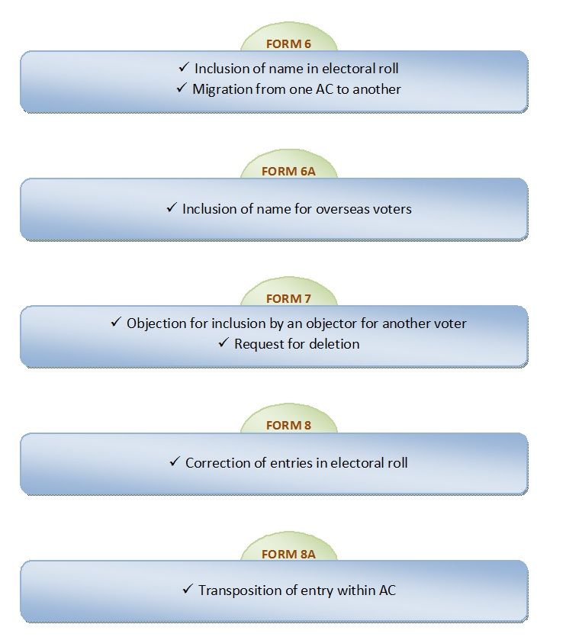

Slide 23
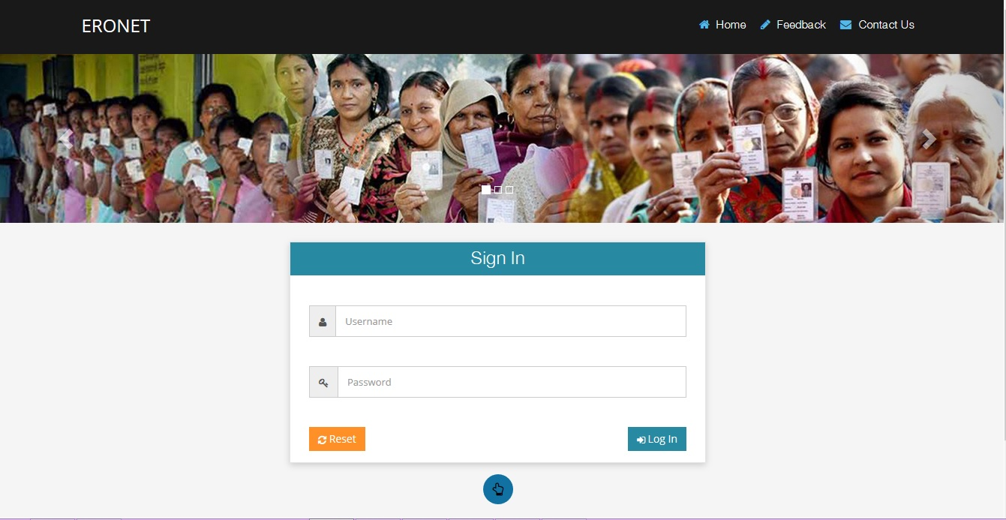
ERONET Home Page
Notes:
Modified Image text ECINET to ERONET

Slide 24
Responsibilities of CEO/Officer 1
Monitor and periodically review the progress of form processing
Review the remaining work with DEOs and EROs

Slide 25
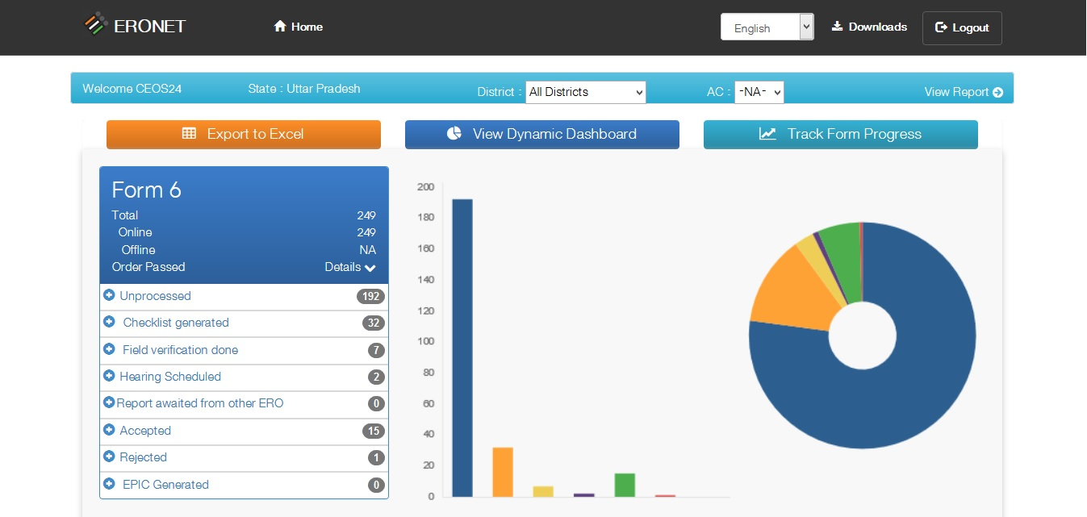
CEO Dashboard

Slide 26
CEO Dynamic Dashboard

Slide 27
Responsibilities of DEO/Officer 2
Monitor and periodically review the progress of form processing
Review the remaining work with EROs

Slide 28
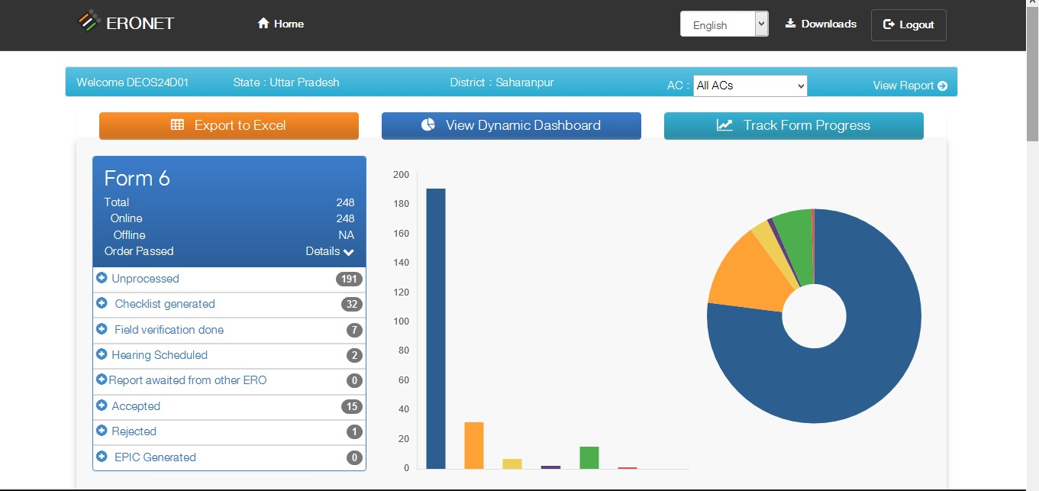
DEO Dashboard

Slide 29
DEO Dynamic Dashboard

Slide 30
User : ERO / Officer 3
ERO Order
Accept/Reject
Schedule hearing
Reinitiate process of field verification
Suo Moto Deletion
Monitors & permits migration of entry to EROs
Deletion request to/from other ERO
Inclusion/Modification/Deletion in E-Roll
E-Roll Management
View Dashboard
BLO Management
Notes:
Modified Approve Forms to Accept Forms

Slide 31
ERO Homepage

Slide 32
User : ERO / Officer 3
ERO Order Accept/Reject
When ERO clicks on this tab he/ she will get the list of forms which are under process.
Here forms 6/ 6A/ 7/ 7A/ 8 could be selected. These forms could be in different states like BLO Appointed, field verified etc. Results could also be filtered on basis of date, part number etc. Forms could also be searched based on either form number or EPIC number. After clicking on ‘Process’ link he/ she gets form on screen which contain information about applicant’s personal details, family details and field verification report.
If ERO has any doubt he/ she can schedule hearing or accept the application.
Notes:
Modified Approve Forms to Accept Forms

Slide 33
ERO Homepage

Slide 34
User : ERO / Officer 3
Suo Moto Deletion
If the person is dead (Registered or Reported).
If he has shifted to new place without deletion old data in ER.
If he is found in old address while he has enrolled in new place.
Demographic similar entry
Notes:
Modified Approve Forms to Accept Forms

Slide 35
ERO Homepage

Slide 36
User : ERO / Officer 3
Deletion Request to/ from other ERO
When ERO clicks on this tab he/ she get the list of forms which already have record or have EPIC number. Here forms 6/ 6A/ 7/ 7A/ 8 could be selected. These forms could be in different states like BLO Appointed, field verified etc. Results could also be filtered on basis of date, part number etc. Forms could also be searched based on either form number or EPIC number. After clicking on ‘Process’ link he/ she gets form on screen which contain information about applicant’s personal details, family details and field verification report.
Notes:
Modified Approve Forms to Accept Forms

Slide 37
ERO Homepage

Slide 38
User : ERO / Officer 3
E-Roll Management
Clicking on ‘Insertion / Modification / Deletion’ tab will lead us to screen which shows accepted forms of all types i.e. form 6/ 6A/ 7/ 8/ 8A. Here ERO can accept form 6 and generate EPIC number and add record in the electoral roll. In case of form 6A entry will be added without generating EPIC while in case of form 7 entries will be deleted from electoral roll and in case of form 8/ 8A existing entries will be modified in electoral roll. EPIC generation can be undertaken for inclusion request forms which have been approved. Following are the screens for generation of EPIC, modification in electoral roll and deletion in electoral roll respectively.
Notes:
Modified Approve Forms to Accept Forms

Slide 39
ERO Homepage

Slide 40
User : ERO / Officer 3
BLO Management
This gives the list of registered BLOs. Here BLO’s details could be modified/ deleted.
Notes:
Modified Approve Forms to Accept Forms

Slide 41
ERO Homepage

Slide 42
User : ERO / Officer 3
View Dashboard
This screen gives summary of all type of forms. After clicking on view dashboard in ERO Home page, we get following screen showing summary of all forms.
Notes:
Modified Approve Forms to Accept Forms

Slide 43
User : AERO / Officer 4
Assign part/ Section/ BLO
Request deletion to other ERO
Submission to ERO
Assign for Scanning (Assign SLA)
View Dashboard
User Management
Update User Details
Notes:
Modified Submission to ERO for approval or rejection to Submission to ERO for acceptance or rejection

Slide 44
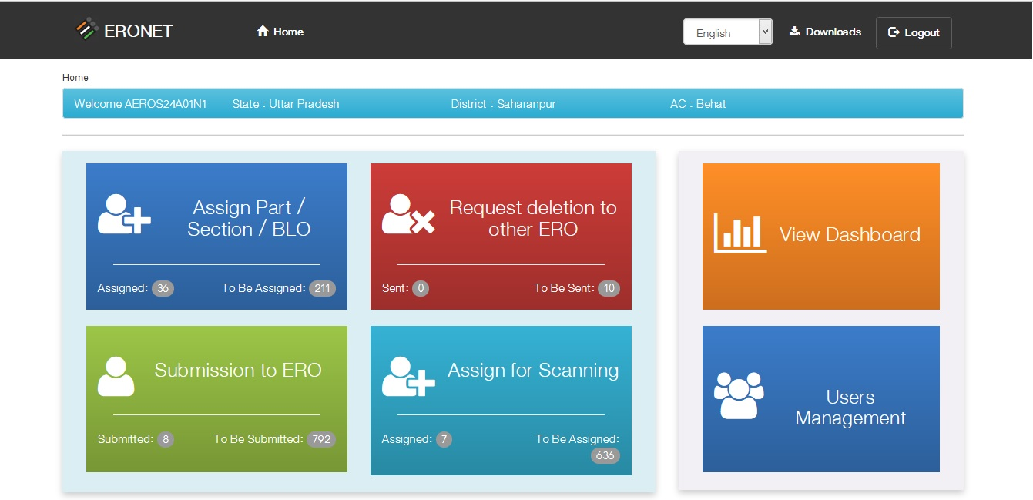
AERO Home Page
Notes:
Modified Image text ECINET to ERONET

Slide 45
User : AERO / Officer 4
Assign Part/Section/BLO
After clicking on this tab AERO gets the list of submitted forms whose part/ section number/ BLO is not assigned. He/ she can assign/ reassign part number/ section number/ BLO here. Also chekclist for filed verification by BLO is generated and handed over to the BLO.
Notes:
Modified Submission to ERO for approval or rejection to Submission to ERO for acceptance or rejection

Slide 46
AERO Home Page
Notes:
Modified Image text ECINET to ERONET

Slide 47
User : AERO / Officer 4
Request deletion to other ERO
After clicking on this tab a list of submitted forms will be displayed on screen. By clicking the ‘Process’ button in list a form processing panel gets opened on screen which contain information about applicant’s personal details, family details, field verification report. If applicant has mentioned part IV details in the form then it will be displayed on the form processing panel along with the ‘deletion request’ button for sending the deletion request to other ERO. If deletion request is already sent then it’s status is shown instead of the ‘deletion request’ button
Notes:
Modified Submission to ERO for approval or rejection to Submission to ERO for acceptance or rejection

Slide 48
AERO Home Page
Notes:
Modified Image text ECINET to ERONET

Slide 49
User : AERO / Officer 4
Submission to ERO for approval or rejection
After clicking on this tab AERO gets a list of forms which could be further filtered on the basis of field verified, BLO assign, and part assign, etc. AERO checks the BLO field verification report and submits the same to ERO along with his remarks.
Notes:
Modified Submission to ERO for approval or rejection to Submission to ERO for acceptance or rejection

Slide 50
AERO Home Page
Notes:
Modified Image text ECINET to ERONET

Slide 51
User : AERO / Officer 4
Assign for Scanning
After clicking on this tab AERO gets a list of forms date wise for which SLA can be assigned. He/ she selects form type and clicks on ‘Generate QR Code button’, this generates a .json file which is handed over to the assigned SLA. If SLA is already assigned then SLA’s name is displayed..
Notes:
Modified Submission to ERO for approval or rejection to Submission to ERO for acceptance or rejection

Slide 52
AERO Home Page
Notes:
Modified Image text ECINET to ERONET

Slide 53
User : AERO / Officer 4
View Dashboard
This screen gives summary of all type of forms. After clicking on view dashboard in ERO Home page, we get following screen showing summary of all forms.
Notes:
Modified Submission to ERO for approval or rejection to Submission to ERO for acceptance or rejection

Slide 54
AERO Home Page
Notes:
Modified Image text ECINET to ERONET

Slide 55
User : AERO / Officer 4
User Management
After clicking on this tab AERO can see details of Users of the system (supervisor, data entry operator). AERO can also add, edit and delete user information.
Notes:
Modified Submission to ERO for approval or rejection to Submission to ERO for acceptance or rejection

Slide 56
User : Supervisor/ Officer 5
View field verification report and provide recommendation to AERO

Slide 57
Supervisor Home Page

Slide 58
User : Supervisor/ Officer 5
Submission to AERO
After clicking on this tab supervisor gets a list of submitted forms under progress, and various states like BLO Appointed, field verified. He/ She can filter list on basis of date/ part number. Forms could be searched on the basis of either form number or EPIC number. After clicking on ‘Process’ link, applicant’s information like his/ her personal details, family details, field verification report could be viewed. Supervisor can add remark and submit form to AERO.

Slide 59
Supervisor Home Page

Slide 60
User : Supervisor/ Officer 5
View Progress
This screen displays the progress of forms.

Slide 61
User : Data entry operator/ Officer 6
Data entry of offline forms to digitize it and filling preliminary scrutiny format
QR code Generation and handing over to Vendor
Upload scanned documents
Enter BLO field verification report
Upload scanned copy of corrected applications and additional support documents collected by BLO
Data entry of corrections
Enter Claims/Objections
Notes:
Modified Enter claims and objections to Enter Claims/Objections

Slide 62
Data Entry Operator Home Page

Slide 63
User : Data entry operator/ Officer 6
Enter Number of forms Received
After clicking on this tab Data Entry Operator gets the screen containing date picker and form list. Here operator should write number of form received as per form type and submit the record.
Notes:
Modified Enter claims and objections to Enter Claims/Objections

Slide 64
Data Entry Operator Home Page

Slide 65
User : Data entry operator/ Officer 6
Offline forms data entry
After clicking on this tab following screen displays, which contains all types of forms so operator can select proper form, make entry and submit the form. This screen also contains guidelines, in ‘.pdf’ format, on how to fill the forms.
Notes:
Modified Enter claims and objections to Enter Claims/Objections

Slide 66
Data Entry Operator Home Page

Slide 67
User : Data entry operator/ Officer 6
Upload scan forms and proofs
By clicking on this tab Data Entry operator can upload scanned documents for further verification and for record purposes. Here Operator can find forms by reference id, form type, and duration when forms were submitted.
Notes:
Modified Enter claims and objections to Enter Claims/Objections

Slide 68
Data Entry Operator Home Page

Slide 69
User : Data entry operator/ Officer 6
Enter BLO report
When Operator clicks on this tab he/ she gets list of forms which are under process. Here forms 6/ 6A/ 7/ 7A/ 8 could be selected. He/ she can filter list on the basis of date/part number. Operator can also search forms on the basis of either form number or EPIC number. After clicking on ‘Process’ link he/ she gets forms on screen which contain applicant’s personal and family details. Here operator makes entry of field verification report.
Notes:
Modified Enter claims and objections to Enter Claims/Objections

Slide 70
Data Entry Operator Home Page

Slide 71
User : Data entry operator/ Officer 6
Enter Claims and objections
Here operator can make entry of claims or objections, if any.
Notes:
Modified Enter claims and objections to Enter Claims/Objections

Slide 72
Data Entry Operator Home Page

Slide 73
User : Data entry operator/ Officer 6
Data corrections
After field verification, if BLO finds some correction then he/she requests ‘mark for correction’. Operator can then make corrections by clicking on this button. After clicking on this button operator will see list of forms which are marked for correction..
Notes:
Modified Enter claims and objections to Enter Claims/Objections

Slide 74
Alerts & Notification
Alerts and Notifications will be generated by system and Sent to
Applicant
AERO/ERO/EO
Supervisor
BLO, ERO, Consulting ERO
As e-mail, SMS and on Mobile App
Contact information as uploaded currently on ecinet.in will be used

Slide 75
Offline Forms - Summary
Hard copies of form received at ERO office from different locations
Entry of forms in register (online), EO monitors manually entry of various forms count
Allocated jobs to data entry operator
Digitization of forms by data entry operator and generate QR code
EOs can view status of forms filled by data entry operator on dashboard
Generates “QR code data file”
EO hands over “QR code data file” and hard copies of forms to SLA for printing of QR codes
SLA/ERO prints QR code and affix the same on bottom right on hard copy of form using “QR code printing tool”
QR code affixed forms given to the SLA for scanning

Slide 76
SLA scans all the forms as per Scanning Guidelines
SLA crops the photograph using suggested software as per guideline (Photo crop guideline)
SLA handover scanned forms softcopy/Hard copy after Quality Check(QC) to the EO with Quality Check report
Data entry operator checks the quality of scanned document using “Scan Quality Checker Tool” and prepares report for scrutiny by EO
Send report of rejected files and hard copies of forms to the SLA for rescanning
Data entry operator uploads the forms one by one by manually verifying the forms data
QR code validation by system in back-end for cross-validation
Dashboard based status of form processing for EO
Further processing of forms are as per online form processing

Slide 77
Q & A

Slide 78
Thank You
Support: eronet-feedback@cdac.in

